Slide 1
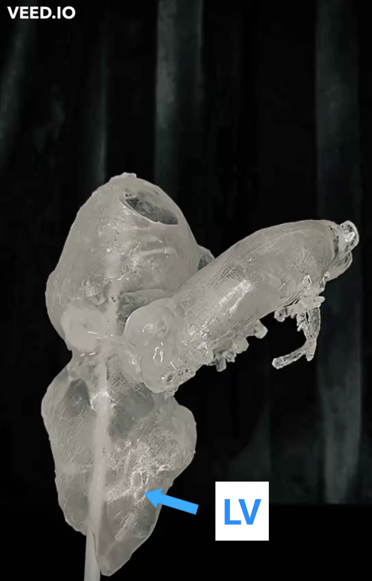
Notes:
Supplement 1 _ video: (3D) printing.
3D: Three-dimensional; LV: left ventricle; Ao: aorta; LA: left atrium; SVG: saphenous venous graft.

